Slide 1
Example of Data Race
with many thanks to
Glenn Rowe and Karen Petrie

Slide 2
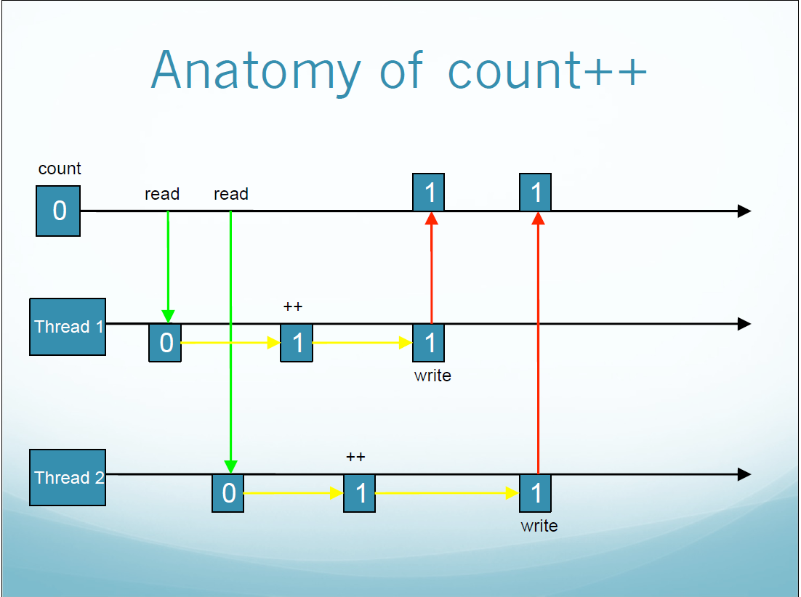

Slide 3
Data Races
Value of count should really be 2 after above
But in this instance it comes out at 1
The count++ operation consists of distinct parts
Possible for two threads to interfere if both try a count++ simultaneously
Gives rise to a data race: two threads racing each other to access common data

Slide 4
Anatomy of count++
In a single count++ operation:
  first read 'count' from memory into a register
  add 1 to count within register
  write new value of count back to main memory
  (return value, although not used here)
Cannot predict when a thread will be interrupted by the other thread
  Because the interrupts might happen at any time.

Slide 5
Data Race with count++
In diagram, both threads read a copy of count into their own registers before it is modified
Both threads start off with a value count == 0
Two ++ operations occur, but final result of count is only 1, not 2.
This is typical Data Race behaviour.

